Slide 1
➔BASIC INSTRUCTIONS ➔ADDRESSING MODES

Slide 2
Presentation Outline
Operand Types
Data Transfer Instructions
Addition and Subtraction
Addressing Modes
Jump and Loop Instructions
Copying a String
Summing an Array of Integers

Slide 3
Three Basic Types of Operands
Immediate
Constant integer (8, 16, or 32 bits)
Constant value is stored within the instruction
Register
Name of a register is specified
Register number is encoded within the instruction
Memory
Reference to a location in memory
Memory address is encoded within the instruction, or
Register holds the address of a memory location

Slide 4
Instruction Operand Notation
Operand | Description
r8 | 8-bit general-purpose register: AH, AL, BH, BL, CH, CL, DH, DL
r16 | 16-bit general-purpose register: AX, BX, CX, DX, SI, DI, SP, BP
r32 | 32-bit general-purpose register: EAX, EBX, ECX, EDX, ESI, EDI, ESP, EBP
reg | Any general-purpose register
sreg | 16-bit segment register: CS, DS, SS, ES, FS, GS
imm | 8-, 16-, or 32-bit immediate value
imm8 | 8-bit immediate byte value
imm16 | 16-bit immediate word value
imm32 | 32-bit immediate doubleword value
r/m8 | 8-bit operand which can be an 8-bit general-purpose register or memory byte
r/m16 | 16-bit operand which can be a 16-bit general-purpose register or memory word
r/m32 | 32-bit operand which can be a 32-bit general register or memory doubleword
mem | 8-, 16-, or 32-bit memory operand

Slide 5
Next . . .
Operand Types
Data Transfer Instructions
Addition and Subtraction
Addressing Modes
Jump and Loop Instructions
Copying a String
Summing an Array of Integers

Slide 6
MOV Instruction
Move source operand to destination
mov destination, source
Source and destination operands can vary
mov reg, reg
mov mem, reg
mov reg, mem
mov mem, imm
mov reg, imm
mov r/m16, sreg
mov sreg, r/m16
Programs running in protected mode should not modify the segment registers
Rules
Both operands must be of same size
No memory to memory moves
Destination cannot be CS, EIP, or IP
No immediate to segment moves

Slide 7
MOV Examples
.DATA
count BYTE 100
bVal BYTE 20
wVal WORD 2
dVal DWORD 5
.CODE
mov bl, count ; bl = count = 100
mov ax, wVal ; ax = wVal = 2
mov count,al ; count = al = 2
mov eax, dval ; eax = dval = 5
; Assembler will not accept the following moves – why?
mov ds, 45
mov esi, wVal
mov eip, dVal
mov 25, bVal
mov bVal,count
; immediate move to DS not permitted
; size mismatch
; EIP cannot be the destination
; immediate value cannot be destination
; memory-to-memory move not permitted

Slide 8
Zero Extension
MOVZX Instruction
Fills (extends) the upper part of the destination with zeros
Used to copy a small source into a larger destination
Destination must be a register
movzx r32, r/m8
movzx r32, r/m16
movzx r16, r/m8
mov bl, 8Fh
movzx ax, bl

Slide 9
Sign Extension
MOVSX Instruction
Fills (extends) the upper part of the destination register with a copy of the source operand's sign bit
Used to copy a small source into a larger destination
movsx r32, r/m8
movsx r32, r/m16
movsx r16, r/m8
mov bl, 8Fh
movsx ax, bl

Slide 10
XCHG Instruction
XCHG exchanges the values of two operands
xchg reg, reg
xchg reg, mem
xchg mem, reg
Rules
Operands must be of the same size
At least one operand must be a register
No immediate operands are permitted
.DATA
var1 DWORD 10000000h
var2 DWORD 20000000h
.CODE
xchg ah, al ; exchange 8-bit regs
xchg ax, bx ; exchange 16-bit regs
xchg eax, ebx ; exchange 32-bit regs
xchg var1,ebx ; exchange mem, reg
xchg var1,var2 ; error: two memory operands

Slide 11
Direct Memory Operands
Variable names are references to locations in memory
Direct Memory Operand:
Named reference to a memory location
Assembler computes address (offset) of named variable
.DATA
var1 BYTE 10h
.CODE
mov al, var1 ; AL = var1 = 10h
mov al,[var1] ; AL = var1 = 10h
Direct Memory Operand
Alternate Format

Slide 12
Direct-Offset Operands
Direct-Offset Operand: Constant offset is added to a named memory location to produce an effective address
Assembler computes the effective address
Lets you access memory locations that have no name
.DATA
arrayB BYTE 10h,20h,30h,40h
.CODE
mov al, arrayB+1 ; AL = 20h
mov al,[arrayB+1] ; alternative notation
mov al, arrayB[1] ; yet another notation
Q: Why doesn't arrayB+1 produce 11h?

Slide 13
Direct-Offset Operands - Examples
.DATA
arrayW WORD 1020h, 3040h, 5060h
arrayD DWORD 1, 2, 3, 4
.CODE
mov ax, arrayW+2
mov ax, arrayW[4]
mov eax,[arrayD+4]
mov eax,[arrayD-3]
mov ax, [arrayW+9]
mov ax, [arrayD+3]
mov ax, [arrayW-2]
mov eax,[arrayD+16]
; AX = 3040h
; AX = 5060h
; EAX = 00000002h
; EAX = 01506030h
; AX = 0200h
; Error: Operands are not same size
; AX = ? Out-of-range address
; EAX = ? MASM does not detect error
1020
3040
5060
1
2
3
4
20
10
40
30
60
50
01
00
00
00
02
00
00
00
03
00
00
00
04
00
00
00
+1
+2
+3
+4
+5
+1
+2
+3
+4
+5
+6
+7
+8
+9
+10
+11
+12
+13
+14
+15
arrayW
arrayD

Slide 14
Your Turn . . .
Given the following definition of arrayD
.DATA
arrayD DWORD 1,2,3
Rearrange the three values in the array as: 3, 1, 2
Solution:
; Copy first array value into EAX
mov eax, arrayD ; EAX = 1
; Exchange EAX with second array element
xchg eax, arrayD[4] ; EAX = 2, arrayD = 1,1,3
; Exchange EAX with third array element
xchg eax, arrayD[8] ; EAX = 3, arrayD = 1,1,2
; Copy value in EAX to first array element
mov arrayD, eax ; arrayD = 3,1,2

Slide 15
Next . . .
Operand Types
Data Transfer Instructions
Addition and Subtraction
Addressing Modes
Jump and Loop Instructions
Copying a String
Summing an Array of Integers

Slide 16
ADD and SUB Instructions
ADD destination, source
destination = destination + source
SUB destination, source
destination = destination – source
Destination can be a register or a memory location
Source can be a register, memory location, or a constant
Destination and source must be of the same size
Memory-to-memory arithmetic is not allowed

Slide 17
Evaluate this . . .
Write a program that adds the following three words:
.DATA
array WORD 890Fh,1276h,0AF5Bh
Solution: Accumulate the sum in the AX register
mov ax, array
add ax,[array+2]
add ax,[array+4] ; what if sum cannot fit in AX?
Solution 2: Accumulate the sum in the EAX register
movzx eax, array ; error to say: mov eax,array
movzx ebx, array[2] ; use movsx for signed integers
add eax, ebx ; error to say: add eax,array[2]
movzx ebx, array[4]
add eax, ebx

Slide 18
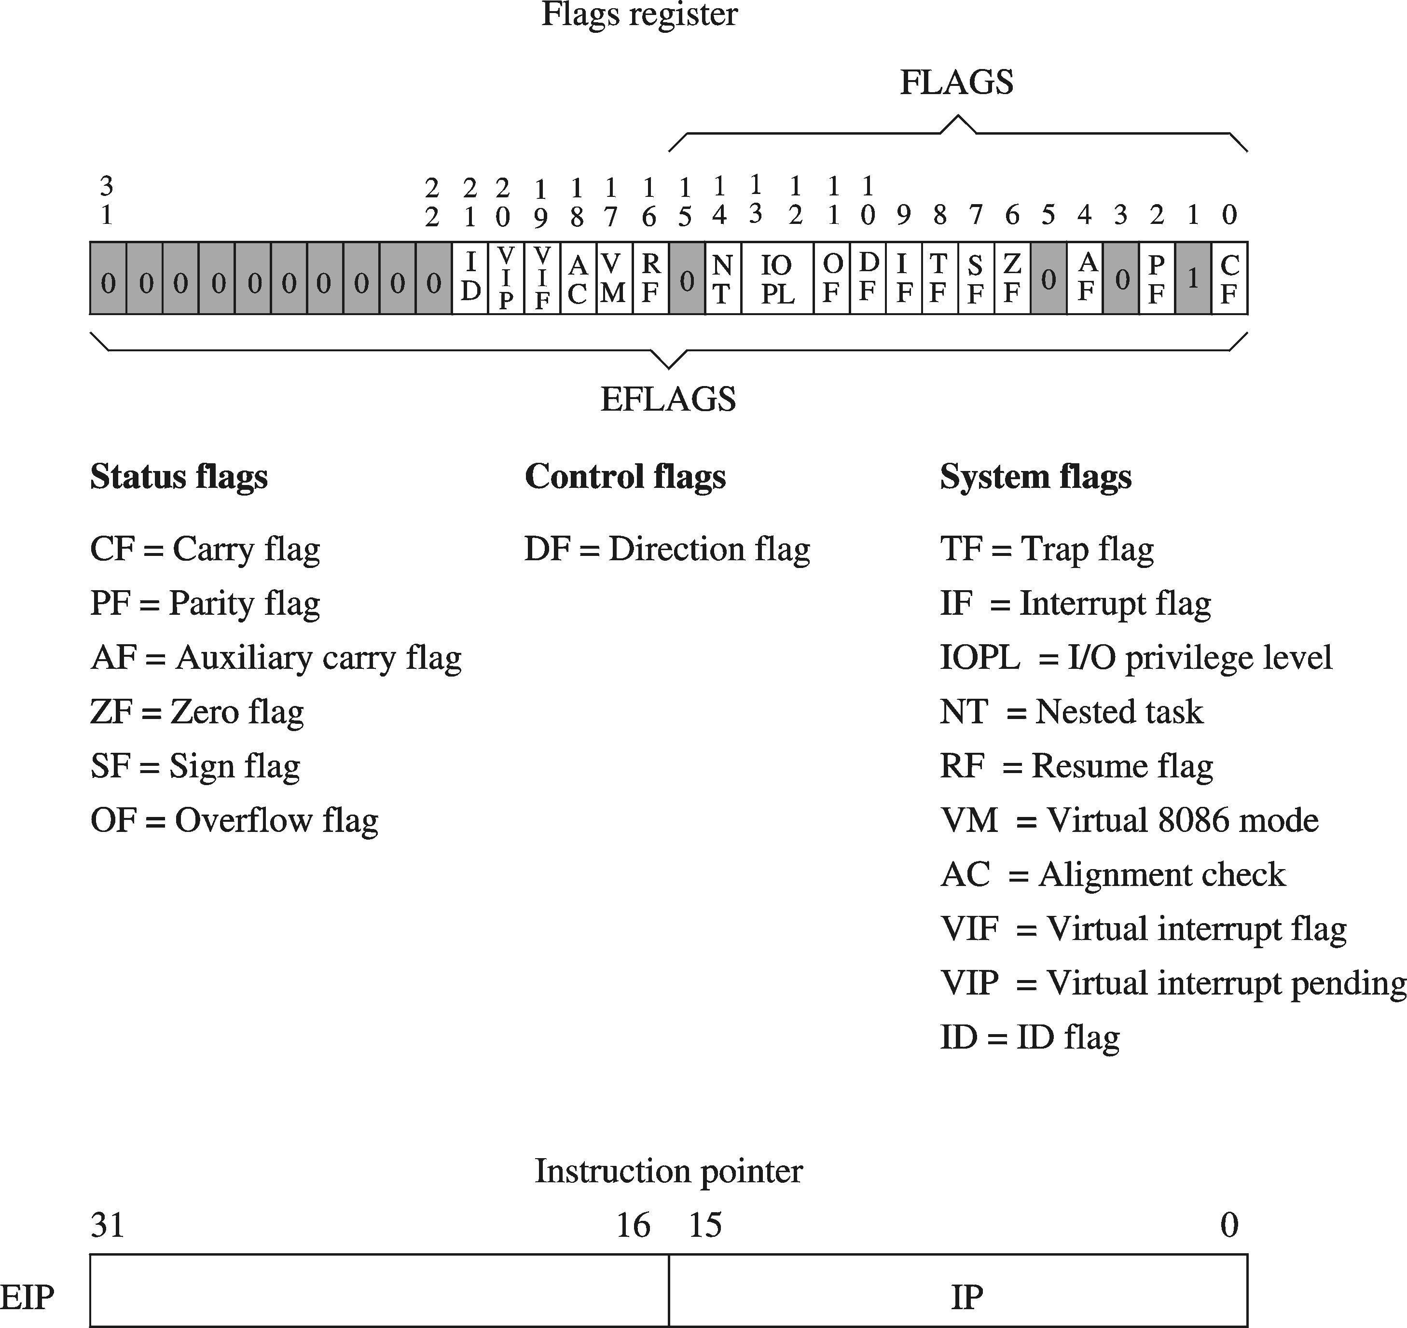
Flags Affected
ADD and SUB affect all the six status flags:
Carry Flag: Set when unsigned arithmetic result is out of range
Overflow Flag: Set when signed arithmetic result is out of range
Sign Flag: Copy of sign bit, set when result is negative
Zero Flag: Set when result is zero
Auxiliary Carry Flag: Set when there is a carry from bit 3 to bit 4
Parity Flag: Set when parity in least-significant byte is even

Slide 19
More on Carry and Overflow
Addition: A + B
The Carry flag is the carry out of the most significant bit
The Overflow flag is only set when . . .
Two positive operands are added and their sum is negative
Two negative operands are added and their sum is positive
Overflow cannot occur when adding operands of opposite signs
Subtraction: A – B
For Subtraction, the carry flag becomes the borrow flag
Carry flag is set when A has a smaller unsigned value than B
The Overflow flag is only set when . . .
A and B have different signs and sign of result ≠ sign of A
Overflow cannot occur when subtracting operands of the same sign

Slide 20
Hardware Viewpoint
CPU cannot distinguish signed from unsigned integers
YOU, the programmer, give a meaning to binary numbers
How the ADD instruction modifies OF and CF:
CF = (carry out of the MSB)
OF = (carry out of the MSB) XOR (carry into the MSB)
Hardware does SUB by …
ADDing destination to the 2's complement of the source operand
How the SUB instruction modifies OF and CF:
Negate (2's complement) the source and ADD it to destination
OF = (carry out of the MSB) XOR (carry into the MSB)
CF = INVERT (carry out of the MSB)
MSB = Most Significant Bit
XOR = eXclusive-OR operation

Slide 21
ADD and SUB Examples
For each of the following marked entries, show the values of the destination operand and the six status flags:
mov al,0FFh ; AL=-1
add al,1 ; AL= CF= OF= SF= ZF= AF= PF=
sub al,1 ; AL= CF= OF= SF= ZF= AF= PF=
mov al,+127 ; AL=7Fh
add al,1 ; AL= CF= OF= SF= ZF= AF= PF=
mov al,26h
sub al,95h ; AL= CF= OF= SF= ZF= AF= PF=
00h 1 0 0 1 1 1
FFh 1 0 1 0 1 1
-128 0 1 1 0 1 0
91h 1 1 1 0 0 0
1
0
0
1
0
0
0
1
0
1
1
0
1
1
1
0
0
0
1
0
0
1
1
0
26h (38)
0
0
1
0
0
1
1
0
26h (38)
–
+
1
0
0
1
0
1
0
1
95h (-107)
0
1
1
0
1
0
1
1
6Bh (107)
1
0
0
1
0
0
0
1
91h (-111)
1
0
0
1
0
0
0
1
91h (-111)

Slide 22
INC, DEC, and NEG Instructions
INC destination
destination = destination + 1
More compact (uses less space) than: ADD destination, 1
DEC destination
destination = destination – 1
More compact (uses less space) than: SUB destination, 1
NEG destination
destination = 2's complement of destination
Destination can be 8-, 16-, or 32-bit operand
In memory or a register
NO immediate operand

Slide 23
Affected Flags
INC and DEC affect five status flags
Overflow, Sign, Zero, Auxiliary Carry, and Parity
Carry flag is NOT modified
NEG affects all the six status flags
Any nonzero operand causes the carry flag to be set
.DATA
B SBYTE -1 ; 0FFh
C SBYTE 127 ; 7Fh
.CODE
inc B ; B= OF= SF= ZF= AF= PF=
dec B ; B= OF= SF= ZF= AF= PF=
inc C ; C= OF= SF= ZF= AF= PF=
neg C ; W= CF= OF= SF= ZF= AF= PF=
0 0 0 1 1 1
-1 0 1 0 1 1
-128=80h 1 1 0 1 0
-128 1 1 1 0 0 0

Slide 24
ADC and SBB Instruction
ADC Instruction: Addition with Carry
ADC destination, source
destination = destination + source + CF
SBB Instruction: Subtract with Borrow
SBB destination, source
destination = destination - source – CF
Destination can be a register or a memory location
Source can be a register, memory location, or a constant
Destination and source must be of the same size
Memory-to-memory arithmetic is not allowed

Slide 25
Extended Arithmetic
ADC and SBB are useful for extended arithmetic
Example: 64-bit addition
Assume first 64-bit integer operand is stored in EBX:EAX
Second 64-bit integer operand is stored in EDX:ECX
Solution:
add eax, ecx ;add lower 32 bits
adc ebx, edx ;add upper 32 bits + carry
64-bit result is in EBX:EAX
STC and CLC Instructions
Used to Set and Clear the Carry Flag

Slide 26
Next . . .
Operand Types
Data Transfer Instructions
Addition and Subtraction
Addressing Modes
Jump and Loop Instructions
Copying a String
Summing an Array of Integers

Slide 27
Addressing Modes
Two Basic Questions
Where are the operands?
How memory addresses are computed?
Intel IA-32 supports 3 fundamental addressing modes
Register addressing: operand is in a register
Immediate addressing: operand is stored in the instruction itself
Memory addressing: operand is in memory
Memory Addressing
Variety of addressing modes
Direct and indirect addressing
Support high-level language constructs and data structures

Slide 28
Register and Immediate Addressing
Register Addressing
Most efficient way of specifying an operand: no memory access
Shorter Instructions: fewer bits are needed to specify register
Compilers use registers to optimize code
Immediate Addressing
Used to specify a constant
Immediate constant is part of the instruction
Efficient: no separate operand fetch is needed
Examples
mov eax, ebx ; register-to-register move
add eax, 5 ; 5 is an immediate constant

Slide 29
Direct Memory Addressing
Used to address simple variables in memory
Variables are defined in the data section of the program
We use the variable name (label) to address memory directly
Assembler computes the offset of a variable
The variable offset is specified directly as part of the instruction
Example
.data
var1 DWORD 100
var2 DWORD 200
sum DWORD ?
.code
mov eax, var1
add eax, var2
mov sum, eax
var1, var2, and sum are direct memory operands

Slide 30
Register Indirect Addressing
Problem with Direct Memory Addressing
Causes problems in addressing arrays and data structures
Does not facilitate using a loop to traverse an array
Indirect memory addressing solves this problem
Register Indirect Addressing
The memory address is stored in a register
Brackets [ ] used to surround the register holding the address
For 32-bit addressing, any 32-bit register can be used
Example
mov ebx, OFFSET array ; ebx contains the address
mov eax, [ebx] ; [ebx] used to access memory
EBX contains the address of the operand, not the operand itself

Slide 31
Array Sum Example
Indirect addressing is ideal for traversing an array
.data
array DWORD 10000h,20000h,30000h
.code
mov esi, OFFSET array ; esi = array address
mov eax,[esi] ; eax = [array] = 10000h
add esi,4 ; why 4?
add eax,[esi] ; eax = eax + [array+4]
add esi,4 ; why 4?
add eax,[esi] ; eax = eax + [array+8]
Note that ESI register is used as a pointer to array
ESI must be incremented by 4 to access the next array element
Because each array element is 4 bytes (DWORD) in memory

Slide 32
Ambiguous Indirect Operands
Consider the following instructions:
mov [EBX], 100
add [ESI], 20
inc [EDI]
Where EBX, ESI, and EDI contain memory addresses
The size of the memory operand is not clear to the assembler
EBX, ESI, and EDI can be pointers to BYTE, WORD, or DWORD
Solution: use PTR operator to clarify the operand size
mov BYTE PTR [EBX], 100 ; BYTE operand in memory
add WORD PTR [ESI], 20 ; WORD operand in memory
inc DWORD PTR [EDI] ; DWORD operand in memory

Slide 33
Indexed Addressing
Combines a variable's name with an index register
Assembler converts variable's name into a constant offset
Constant offset is added to register to form an effective address
Syntax: [name + index] or name [index]
.data
array DWORD 10000h,20000h,30000h
.code
mov esi, 0 ; esi = array index
mov eax,array[esi] ; eax = array[0] = 10000h
add esi,4
add eax,array[esi] ; eax = eax + array[4]
add esi,4
add eax,[array+esi] ; eax = eax + array[8]

Slide 34
Index Scaling
Useful to index array elements of size 2, 4, and 8 bytes
Syntax: [name + index * scale] or name [index * scale]
Effective address is computed as follows:
Name's offset + Index register * Scale factor
.DATA
arrayB BYTE 10h,20h,30h,40h
arrayW WORD 100h,200h,300h,400h
arrayD DWORD 10000h,20000h,30000h,40000h
.CODE
mov esi, 2
mov al, arrayB[esi] ; AL = 30h
mov ax, arrayW[esi*2] ; AX = 300h
mov eax, arrayD[esi*4] ; EAX = 30000h

Slide 35
Based Addressing
Syntax: [Base + Offset]
Effective Address = Base register + Constant Offset
Useful to access fields of a structure or an object
Base Register → points to the base address of the structure
Constant Offset → relative offset within the structure
.DATA
mystruct WORD 12
DWORD 1985
BYTE 'M'
.CODE
mov ebx, OFFSET mystruct
mov eax, [ebx+2] ; EAX = 1985
mov al, [ebx+6] ; AL = 'M'
mystruct is a structure consisting of 3 fields: a word, a double word, and a byte

Slide 36
Based-Indexed Addressing
Syntax: [Base + (Index * Scale) + Offset]
Scale factor is optional and can be 1, 2, 4, or 8
Useful in accessing two-dimensional arrays
Offset: array address => we can refer to the array by name
Base register: holds row address => relative to start of array
Index register: selects an element of the row => column index
Scaling factor: when array element size is 2, 4, or 8 bytes
Useful in accessing arrays of structures (or objects)
Base register: holds the address of the array
Index register: holds the element address relative to the base
Offset: represents the offset of a field within a structure

Slide 37
Based-Indexed Examples
.data
matrix DWORD 0, 1, 2, 3, 4 ; 4 rows, 5 cols
DWORD 10,11,12,13,14
DWORD 20,21,22,23,24
DWORD 30,31,32,33,34
ROWSIZE EQU SIZEOF matrix ; 20 bytes per row
.code
mov ebx, 2*ROWSIZE ; row index = 2
mov esi, 3 ; col index = 3
mov eax, matrix[ebx+esi*4] ; EAX = matrix[2][3]
mov ebx, 3*ROWSIZE ; row index = 3
mov esi, 1 ; col index = 1
mov eax, matrix[ebx+esi*4] ; EAX = matrix[3][1]

Slide 38
LEA Instruction
LEA = Load Effective Address
LEA r32, mem (Flat-Memory)
LEA r16, mem (Real-Address Mode)
Calculate and load the effective address of a memory operand
Flat memory uses 32-bit effective addresses
Real-address mode uses 16-bit effective addresses
LEA is similar to MOV … OFFSET, except that:
OFFSET operator is executed by the assembler
Used with named variables: address is known to the assembler
LEA instruction computes effective address at runtime
Used with indirect operands: effective address is known at runtime

Slide 39
LEA Examples
.data
array WORD 1000 DUP(?)
.code ; Equivalent to . . .
lea eax, array ; mov eax, OFFSET array
lea eax, array[esi] ; mov eax, esi
; add eax, OFFSET array
lea eax, array[esi*2] ; mov eax, esi
; add eax, eax
; add eax, OFFSET array
lea eax, [ebx+esi*2] ; mov eax, esi
; add eax, eax
; add eax, ebx

Slide 40
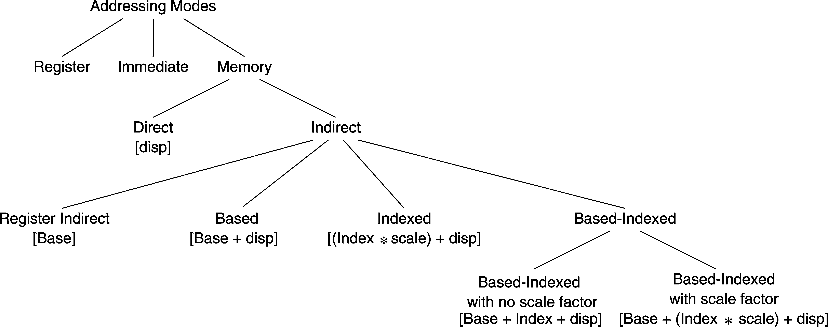
Summary of Addressing Modes
Assembler converts a variable name into a constant offset (called also a displacement)
For indirect addressing, a base/index register contains an address/index
CPU computes the effective address of a memory operand

Slide 41
Registers Used in 32-Bit Addressing
32-bit addressing modes use the following 32-bit registers
Base + ( Index * Scale ) + displacement
EAX EAX 1 no displacement
EBX EBX 2 8-bit displacement
ECX ECX 4 32-bit displacement
EDX EDX 8
ESI ESI
EDI EDI
EBP EBP
ESP
Only the index register can have a scale factor
ESP can be used as a base register, but not as an index

Slide 42
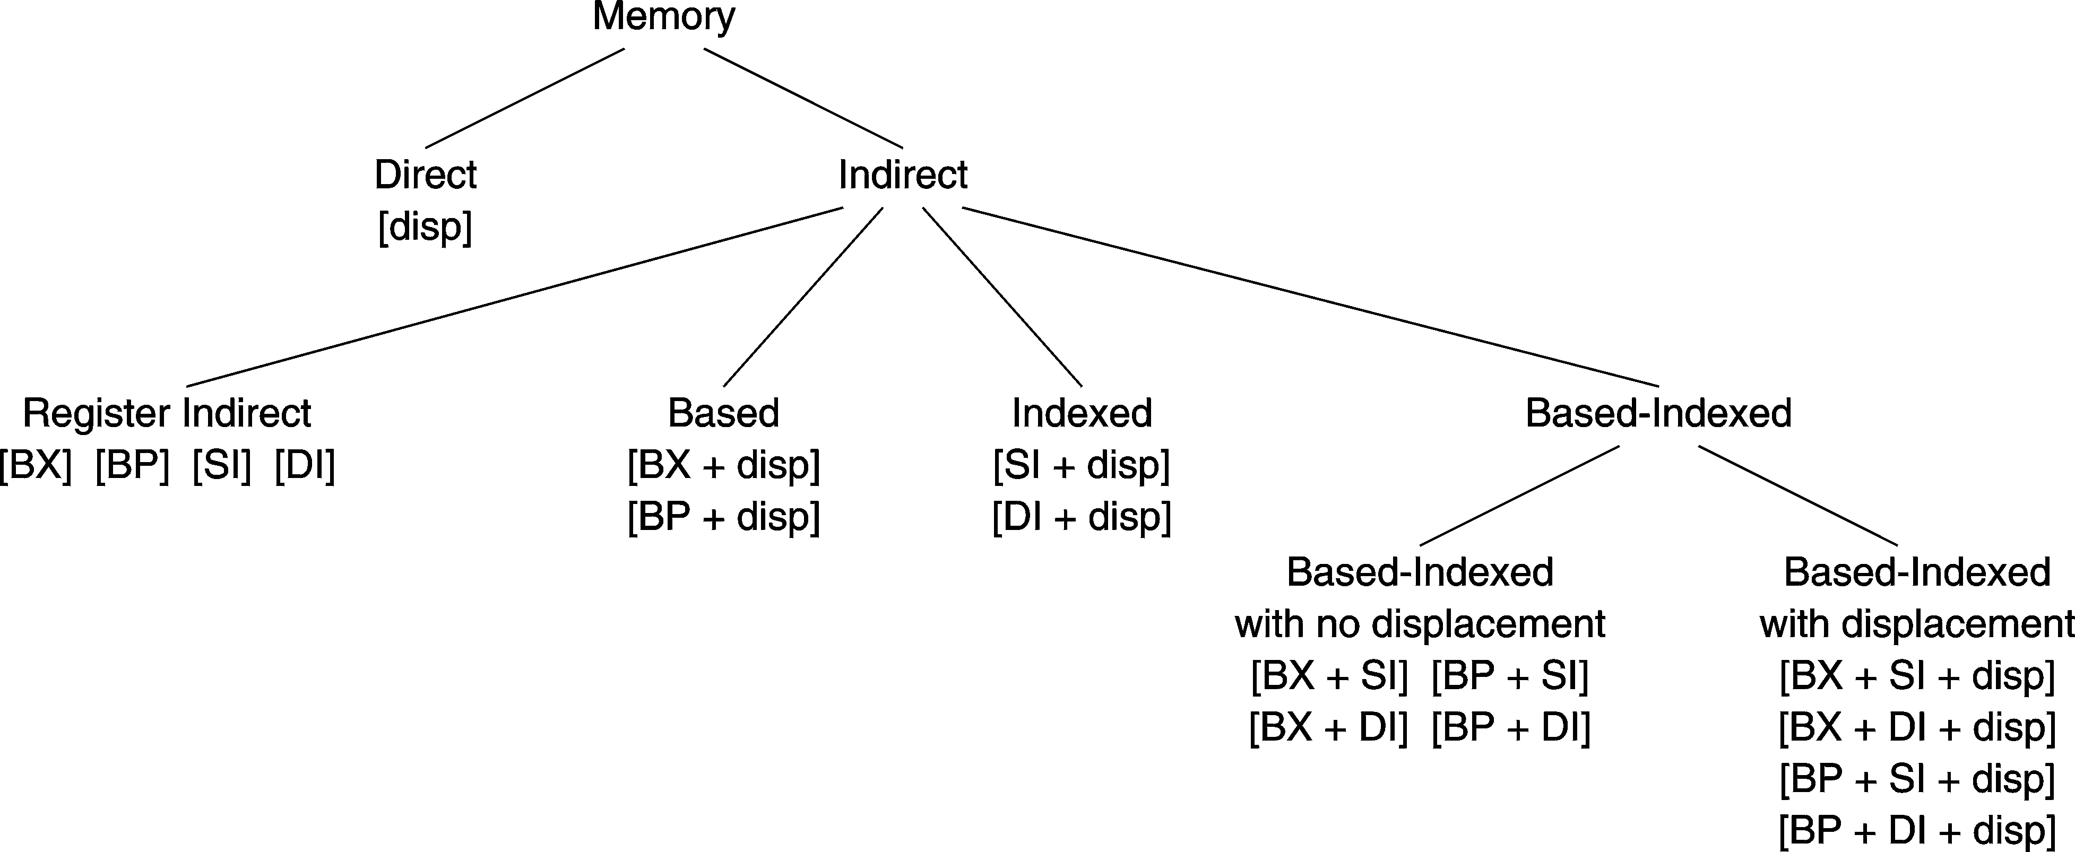
16-bit Memory Addressing
Old 16-bit addressing mode
Used with real-address mode
Only 16-bit registers are used
No Scale Factor
Only BX or BP can be the base register
Only SI or DI can be the index register
Displacement can be 0, 8, or 16 bits

Slide 43
Default Segments
When 32-bit register indirect addressing is used …
Address in EAX, EBX, ECX, EDX, ESI, and EDI is relative to DS
Address in EBP and ESP is relative to SS
In flat-memory model, DS and SS are the same segment
Therefore, no need to worry about the default segment
When 16-bit register indirect addressing is used …
Address in BX, SI, or DI is relative to the data segment DS
Address in BP is relative to the stack segment SS
In real-address mode, DS and SS can be different segments
We can override the default segment using segment prefix
mov ax, ss:[bx] ; address in bx is relative to stack segment
mov ax, ds:[bp] ; address in bp is relative to data segment

Slide 44
Next . . .
Operand Types
Data Transfer Instructions
Addition and Subtraction
Addressing Modes
Jump and Loop Instructions
Copying a String
Summing an Array of Integers

Slide 45
JMP Instruction
JMP is an unconditional jump to a destination instruction
Syntax: JMP destination
JMP causes the modification of the EIP register
EIP ← destination address
A label is used to identify the destination address
Example:
JMP provides an easy way to create a loop
Loop will continue endlessly unless we find a way to terminate it
top:
. . .
jmp top

Slide 46
LOOP Instruction
The LOOP instruction creates a counting loop
Syntax: LOOP destination
Logic: ECX ← ECX – 1
if ECX != 0, jump to destination label
ECX register is used as a counter to count the iterations
Example: calculate the sum of integers from 1 to 100
mov eax, 0 ; sum = eax
mov ecx, 100 ; count = ecx
L1:
add eax, ecx ; accumulate sum in eax
loop L1 ; decrement ecx until 0

Slide 47
Your turn . . .
mov eax,6
mov ecx,4
L1:
inc eax
loop L1
What will be the final value of EAX?
Solution: 10
How many times will the loop execute?
mov eax,1
mov ecx,0
L2:
dec eax
loop L2
Solution: 2³² = 4,294,967,296
What will be the final value of EAX?
Solution: same value 1

Slide 48
Nested Loop
If you need to code a loop within a loop, you must save the outer loop counter's ECX value
.DATA
count DWORD ?
.CODE
mov ecx, 100 ; set outer loop count to 100
L1:
mov count, ecx ; save outer loop count
mov ecx, 20 ; set inner loop count to 20
L2: .
.
loop L2 ; repeat the inner loop
mov ecx, count ; restore outer loop count
loop L1 ; repeat the outer loop

Slide 49
Next . . .
Operand Types
Data Transfer Instructions
Addition and Subtraction
Addressing Modes
Jump and Loop Instructions
Copying a String
Summing an Array of Integers

Slide 50
Copying a String
The following code copies a string from source to target
.DATA
source BYTE "This is the source string",0
target BYTE SIZEOF source DUP(0)
.CODE
main PROC
mov esi,0 ; index register
mov ecx, SIZEOF source ; loop counter
L1:
mov al,source[esi] ; get char from source
mov target[esi],al ; store it in the target
inc esi ; increment index
loop L1 ; loop for entire string
exit
main ENDP
END main
Good use of SIZEOF
ESI is used to index source & target strings

Slide 51
Summing an Integer Array
This program calculates the sum of an array of 16-bit integers
.DATA
intarray WORD 100h,200h,300h,400h,500h,600h
.CODE
main PROC
mov esi, OFFSET intarray ; address of intarray
mov ecx, LENGTHOF intarray ; loop counter
mov ax, 0 ; zero the accumulator
L1:
add ax, [esi] ; accumulate sum in ax
add esi, 2 ; point to next integer
loop L1 ; repeat until ecx = 0
exit
main ENDP
END main
esi is used as a pointer
contains the address of an array element

Slide 52
Summing an Integer Array – cont'd
This program calculates the sum of an array of 32-bit integers
.DATA
intarray DWORD 10000h,20000h,30000h,40000h,50000h,60000h
.CODE
main PROC
mov esi, 0 ; index of intarray
mov ecx, LENGTHOF intarray ; loop counter
mov eax, 0 ; zero the accumulator
L1:
add eax, intarray[esi*4] ; accumulate sum in eax
inc esi ; increment index
loop L1 ; repeat until ecx = 0
exit
main ENDP
END main
esi is used as a scaled index

Slide 53
PC-Relative Addressing
The following loop calculates the sum: 1 to 1000
Offset Machine Code Source Code
00000000 B8 00000000 mov eax, 0
00000005 B9 000003E8 mov ecx, 1000
0000000A L1:
0000000A 03 C1 add eax, ecx
0000000C E2 FC loop L1
0000000E . . . . . .
When LOOP is assembled, the label L1 in LOOP is translated as FC which is equal to –4 (decimal). This causes the loop instruction to jump 4 bytes backwards from the offset of the next instruction. Since the offset of the next instruction = 0000000E, adding –4 (FCh) causes a jump to location 0000000A. This jump is called PC-relative.

Slide 54
PC-Relative Addressing – cont'd
Assembler:
Calculates the difference (in bytes), called PC-relative offset, between the offset of the target label and the offset of the following instruction
Processor:
Adds the PC-relative offset to EIP when executing LOOP instruction
If the PC-relative offset is encoded in a single signed byte,
(a) what is the largest possible backward jump?
(b) what is the largest possible forward jump?
Answers: (a) –128 bytes and (b) +127 bytes

Slide 55
Summary
Data Transfer
MOV, MOVSX, MOVZX, and XCHG instructions
Arithmetic
ADD, SUB, INC, DEC, NEG, ADC, SBB, STC, and CLC
Carry, Overflow, Sign, Zero, Auxiliary and Parity flags
Addressing Modes
Register, immediate, direct, indirect, indexed, based-indexed
Load Effective Address (LEA) instruction
32-bit and 16-bit addressing
JMP and LOOP Instructions
Traversing and summing arrays, copying strings
PC-relative addressing

